Slide 1

Discover the Magic of Essential Oils

Slide 2




ROSE OIL
Hydrates and moisturizes dry skin
Contains anti-aging properties, reduces wrinkles
Calms the mind and reduces stress

Slide 3


LEMON OIL
Pain relief and anti-inflammatory properties
Alleviates digestive issues like bloating and indigestion
Helps with acne and brightens complexion.

Slide 4
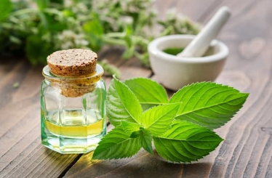

LAVENDER OIL
Helps reduce stress and anxiety
Calms mind and improves sleep quality
Relieves skin irritation, sunburn, and acne

Slide 5
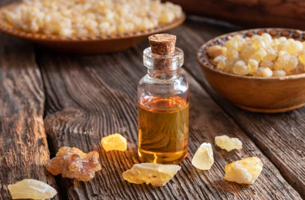

PEPPERMINT OIL
Reduces headaches and migraines
Increases alertness and combats fatigue
Alleviates indigestion, bloating, and nausea

Slide 6

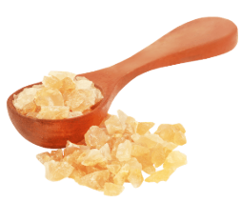
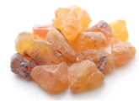
FRANKINCENCE OIL
Reduces appearance of scars, stretch marks
Provides respiratory relief and clears nasal passage
Promotes relaxation and mental clarity

